Slide 1

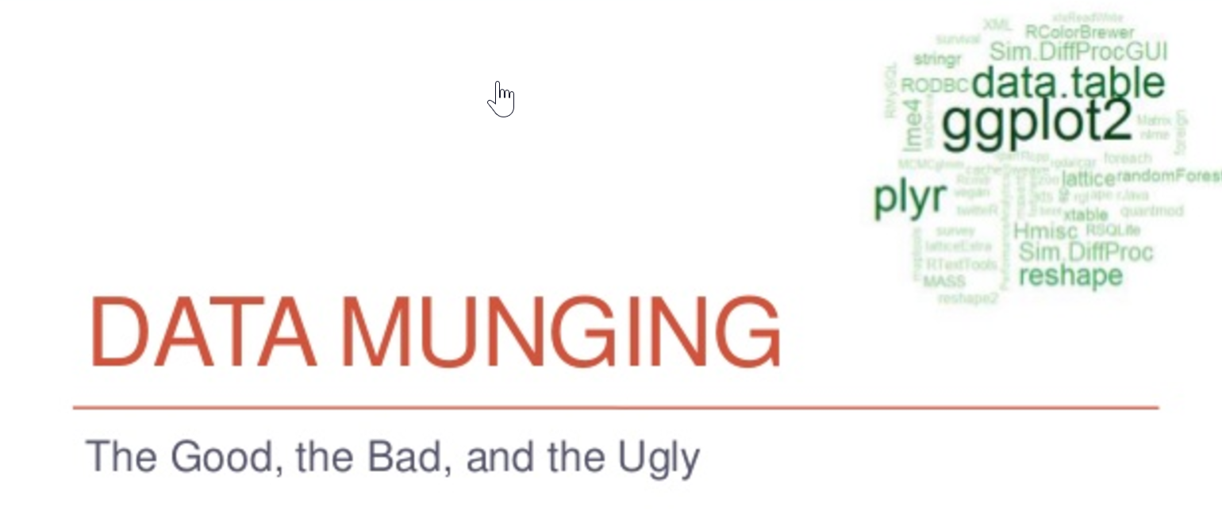
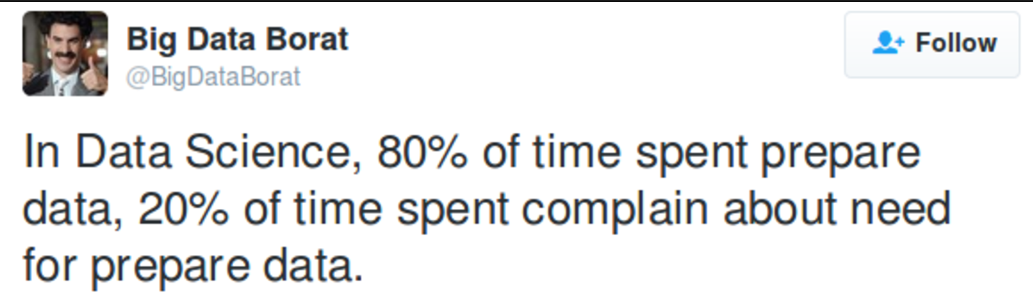

Slide 2

Data Wrangling/Munging
Data wrangling (sometimes referred to as data munging) is the process of transforming and mapping data from one “raw” data form to into another “format”with the intent of making it more appropriate and valuable for a variety of downstream processes such as analytics.
A data wrangler describes the person that preforms these transformation operations
This may include further munging, data visualization, data aggregation, training a statistical model, as well as many other potential uses.
Data munging as a process typically follows a set of general steps which begin with extracting the data in a raw form from the data source, "munging" the raw data using algorithms (e.g. sorting) or parsing the data into predefined data structures, and finally depositing the resulting content into a data sink for storage and future use
From Wikipedia, the free encyclopedia

Slide 3
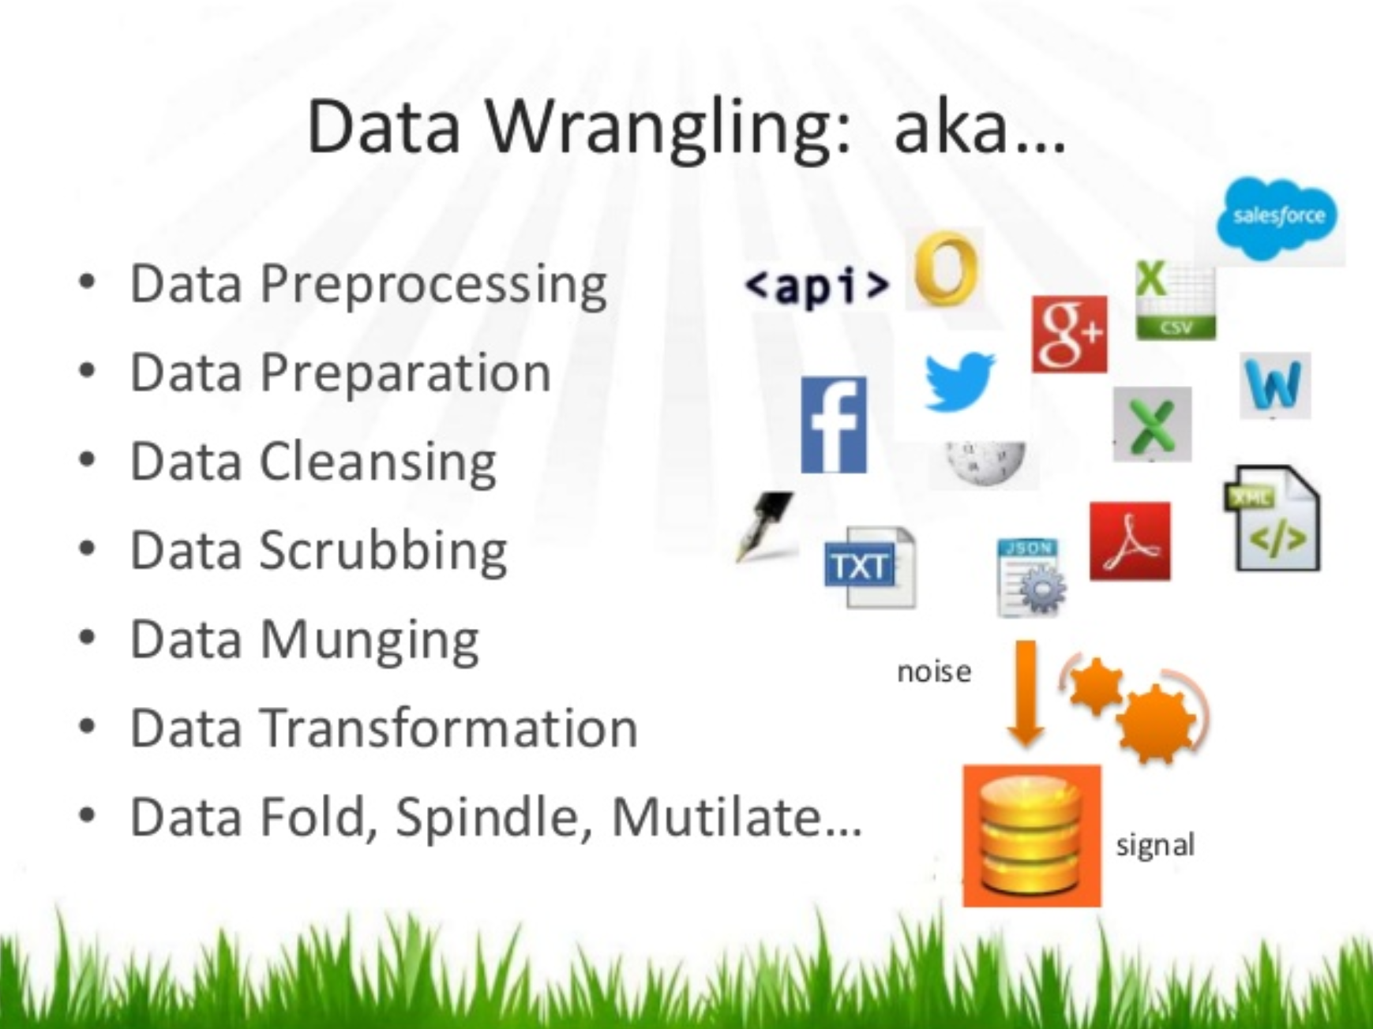
Data Wrangling/Munging

Slide 4
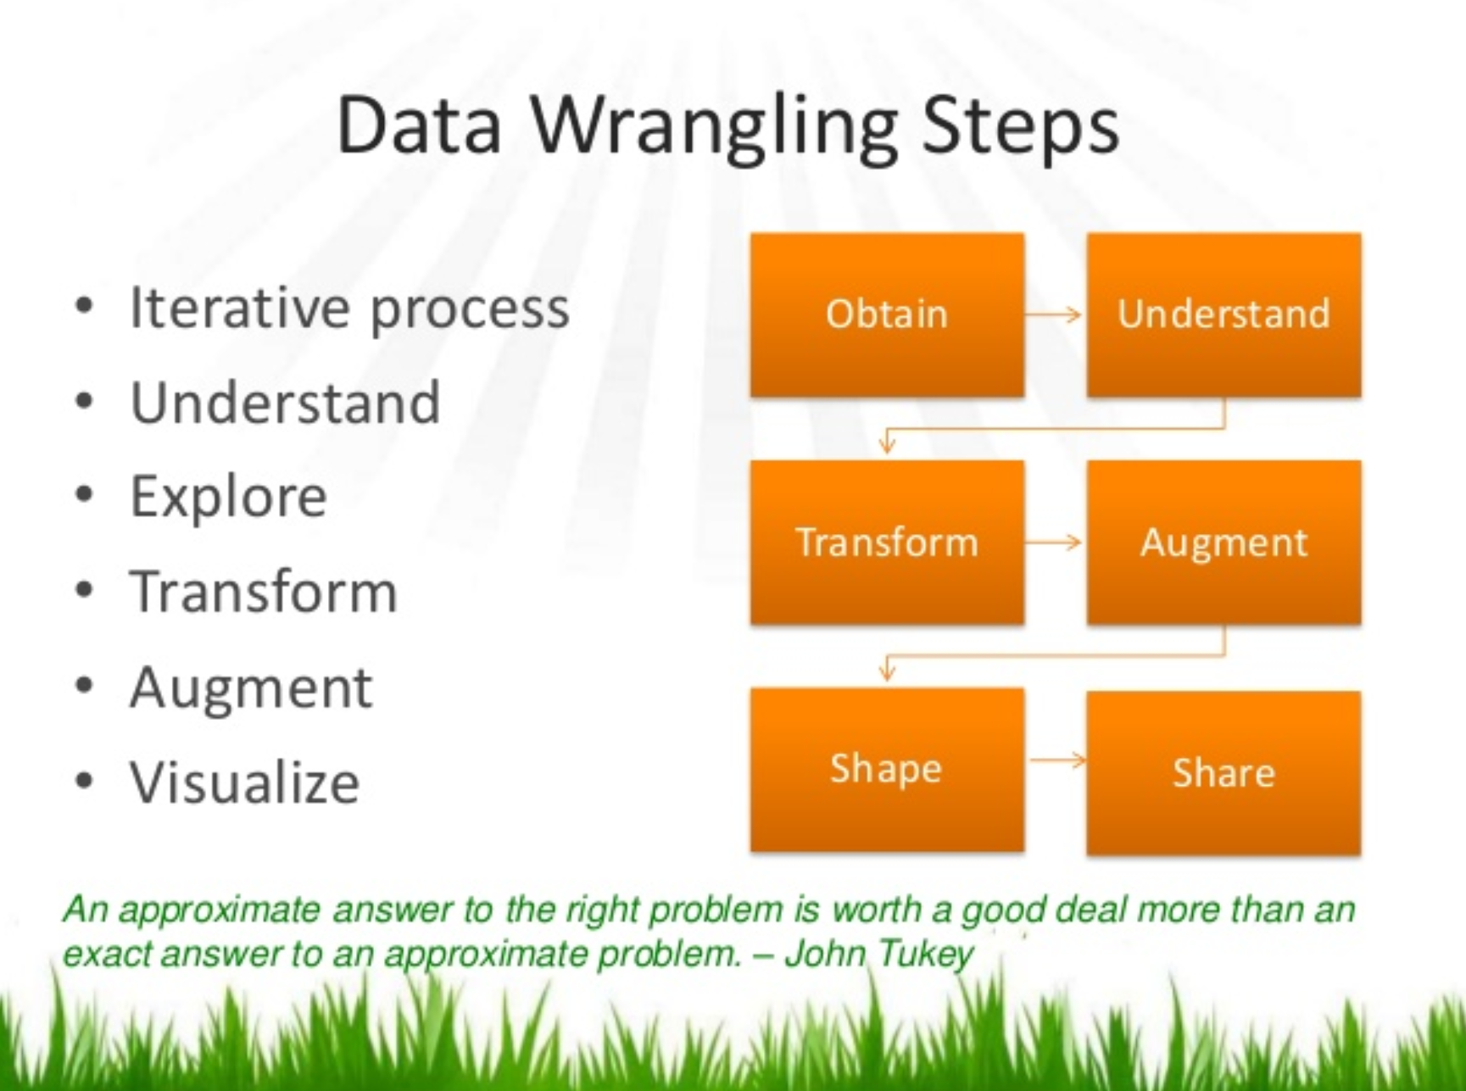
Data Wrangling/Munging

Slide 5
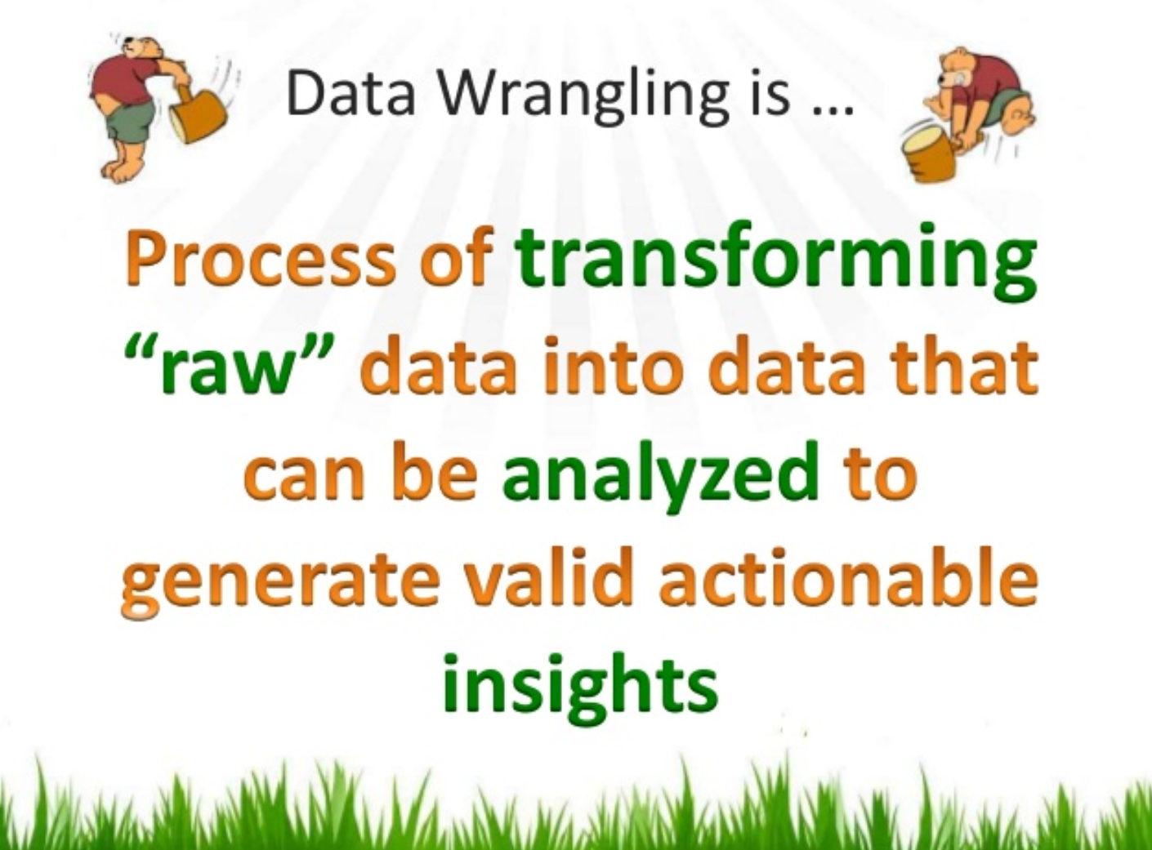
Data Wrangling/Munging

Slide 6
Data Wrangling/Munging
Wrangling, Munging, Preparation, Preprocessing…
“process of manually converting or mapping data from one "raw" form into another format that allows for more convenient consumption of the data with the help of semi-automated tools “
What percent of a data analytics project is traditionally consumed by “data preparation?”
Why is it (still) a big deal?

Slide 7

Data Wrangling/Munging
417-865-8701, (417)865-8701, 8658701, 417-8658701
Missoura, MO, Mis, Miss, MZ, MS, Miz, Mizz
PO Box 34, P.O. Box 34, Box 34, Bx 34, P.O Box 34
Mallery, Malery, Mallrey, Mallory, Malory

Slide 8
Data Wrangling/Munging
Initial “profiling” or handshake
Proper format for analysis tool
Identify and remove anomalies and errors (cleansing)
Standardize / normalize data
Proper data types for fields
Creation of “metadata” fields (“virtual fields”)
Enhancements – outside data (Open Data, etc.)
Articulation of data (does it make sense?)
Preservation and logging (audit trail)

Slide 9
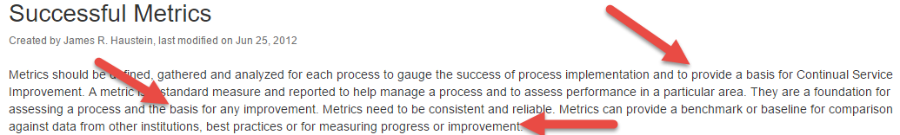
Data Wrangling/Munging
Specific
Measurable
Achievable
Realistic
Timely
Resources:
https://confluence.cornell.edu/display/metrics/Successful+Metrics

Slide 10
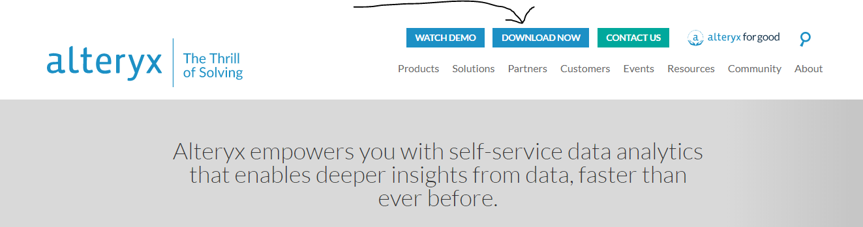
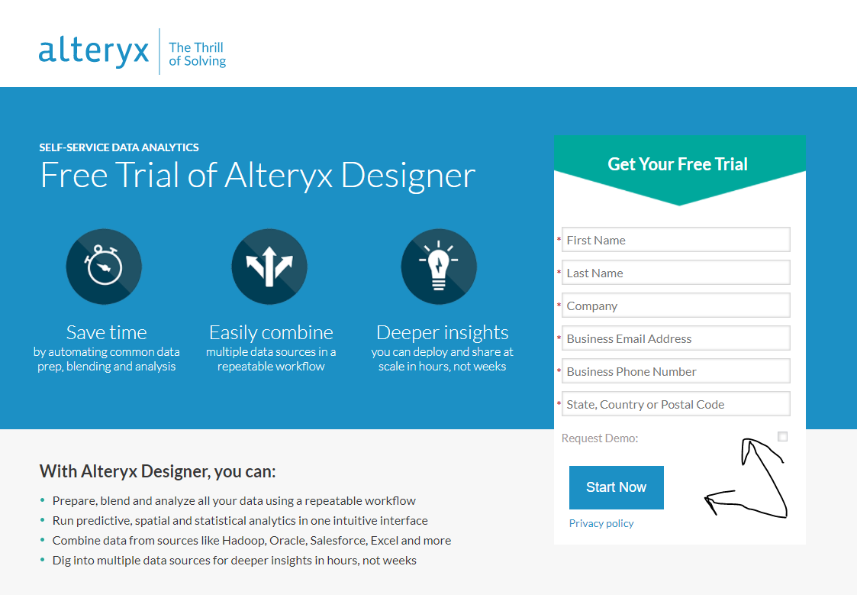
Data Wrangling/Munging
https://www.alteryx.com/
Use the Cloud Version
You will not need to load anything. It is limited to 90 minutes per session.

Slide 11
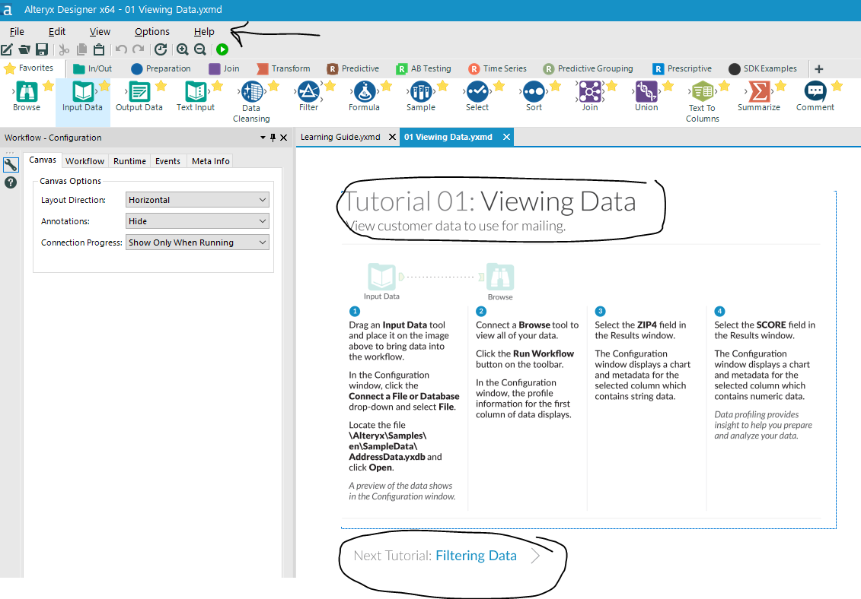
Data Wrangling/Munging
Alteryx Tutorials
https://www.youtube.com/watch?v=_n_sWv64h3w
https://www.youtube.com/watch?v=e6b4dRHwQ7s
https://www.youtube.com/watch?v=zquiSMvxrhU
https://www.youtube.com/watch?v=BOIyyg64Hmc
Another source for help is from Alteryx Academy
https://community.alteryx.com/t5/Alteryx-Academy/ct-p/alteryx-academy
Help inside product:

Slide 12
Data Munging Week 3 Homework
Assignment 3
Part 1
Youtube Videos:
https://www.youtube.com/watch?v=LFDAQfN0L9k
https://www.youtube.com/watch?v=qbYYamU42Sw
https://www.youtube.com/watch?v=gyBI6arfMzs
Business Objective:
Submit: Create an ipython notebook that a student could use to learn about the data munging examples covered in the three videos (html)
Submit: data set used for data munging/analysis
Script should include code blocks that represent data analysis/data munging
Script should provide code that supports the import/export of data into/out of the ipython notebook
Script should include all comments to explain what the code block is doing

Slide 13
Data Wrangling/Munging
Part 2:
Data munge and prepare reports using dataset Marathon Data (use the data set in this weeks content folder)
Add Headers: Name, Jersey Number, Gender, Age, Home Town, Final Time, etc.
Use either data munging environment you would like (R, Python)
Convert all text to caps, do record counts by State, timeline analysis by age (group by )
Produce these reports:
a. All runners (no percentages)
b. All male runners
c. All female runners
Which State has the fastest runners by gender

Slide 14
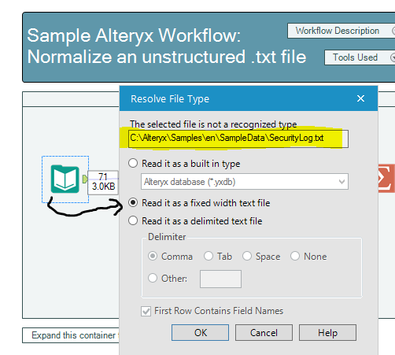
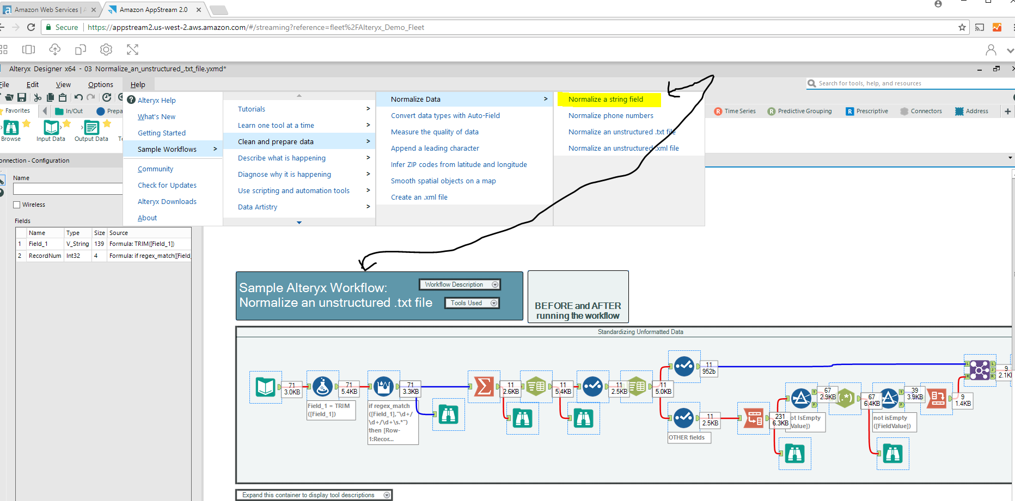
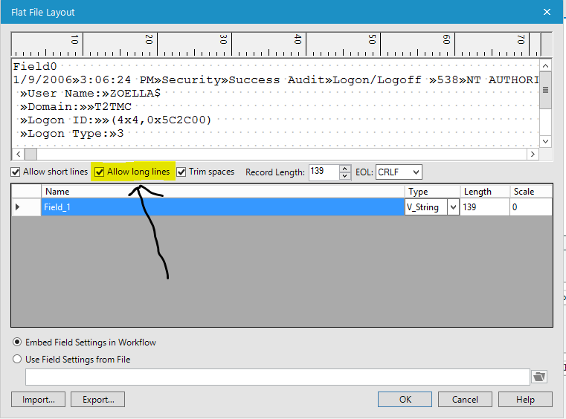
Data Wrangling/Munging
Part 3: Use Alteryx Use the free Cloud version
Review the Sample data cleansing of an unstructured file (see below)
You will need to click on the Input file and find the Security file and choose Fixed Width (see side screen shots)
Compare and contrast Alteryx, Azure ML Studio, and Open Refine doing the following:
Pro’s and Con’s of each version
The tool you would bring to your workplace if you needed a visual tool

Slide 15
Data Wrangling/Munging
Part 4:
Reading Assignment: Big Data Processing Algorithms
Answer Questions:
Explain what MapReduce does and give an example in your own words or a diagram.
Explain the Importance of YARN
Part 5 (Team Effort)
Final Project Plan
Team Name (aka A, B, C, etc.)
Team Members
Week by Week Plan to complete the final project
List Strategies to share the workload and overcome obstacles

Slide 16
Data Wrangling/Munging
Due Date: 2/27/2018 5:45PM
Final Project (Group Effort)
Complete the 3 – Node Hadoop Cluster Instructional Guide Reference A
Business Objective: Develop a clear understanding of the Hadoop Big Data Architecture and EcoSystem using basic Linux commands in a Raspberry Pi hardware development environment.
Deliverables:
An enhanced Instructional Guide
15 Minute class presentation on what was learned, what was enhanced from original document and a representation of additional screen shots, flow diagrams, key word definitions etc. All team members are expected to speak during the presentation.
Executive level presentation.

